Slide 1
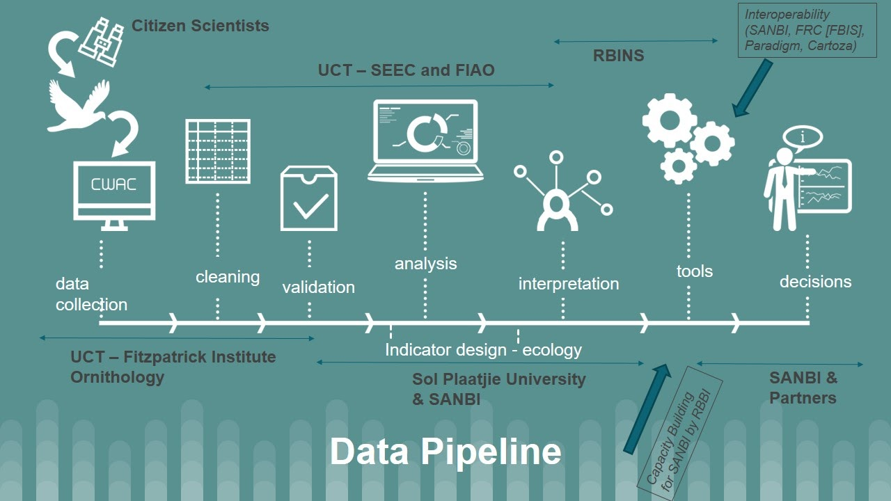
BIRDIE

Slide 2

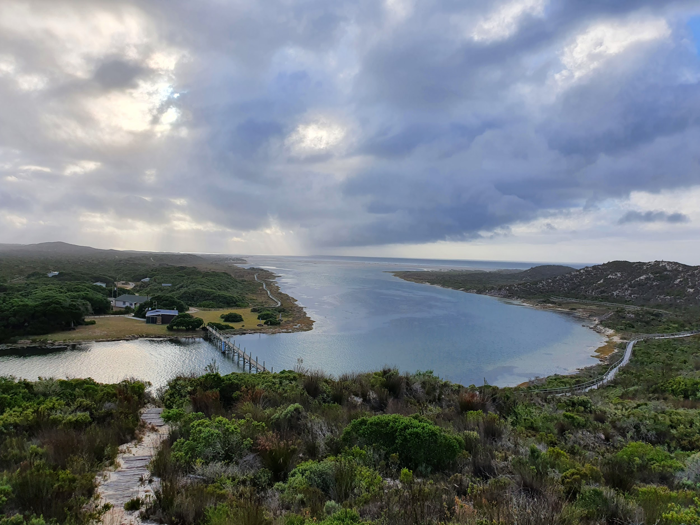
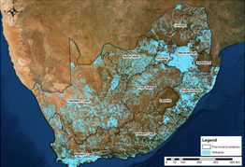


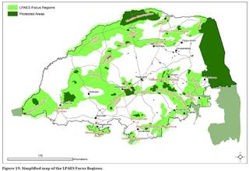

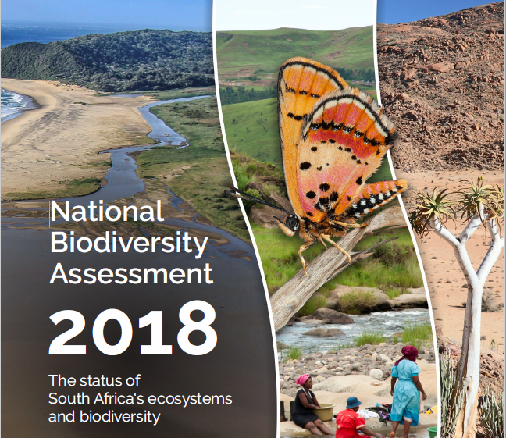


Research
International agreements
Site management
Policy
Citizen science
National and local reporting
Data capture and recreation
Data
Indicators
Decisions

Slide 3

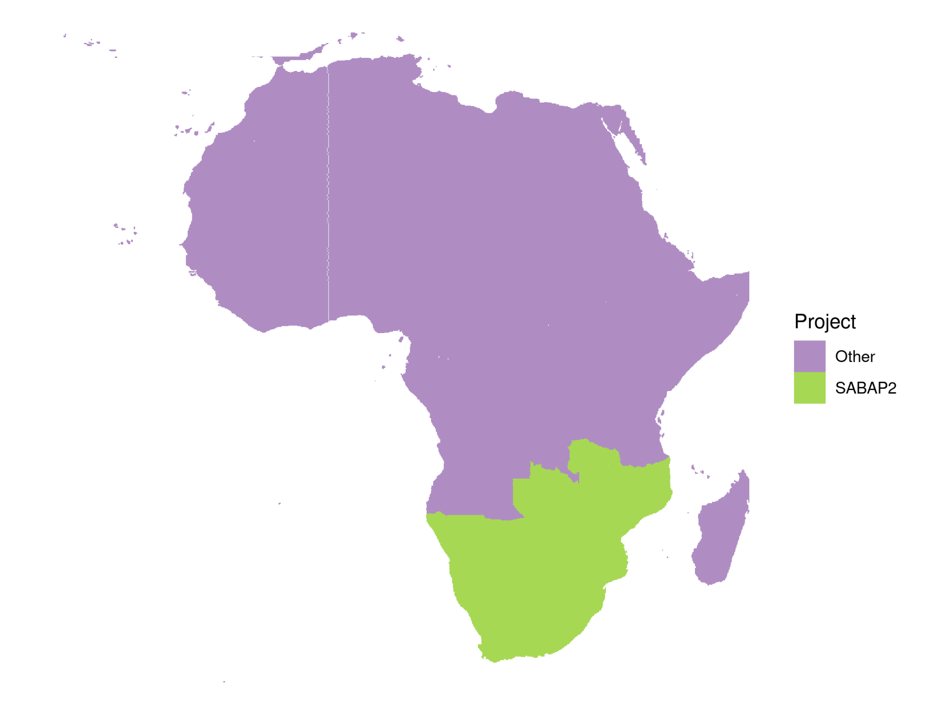
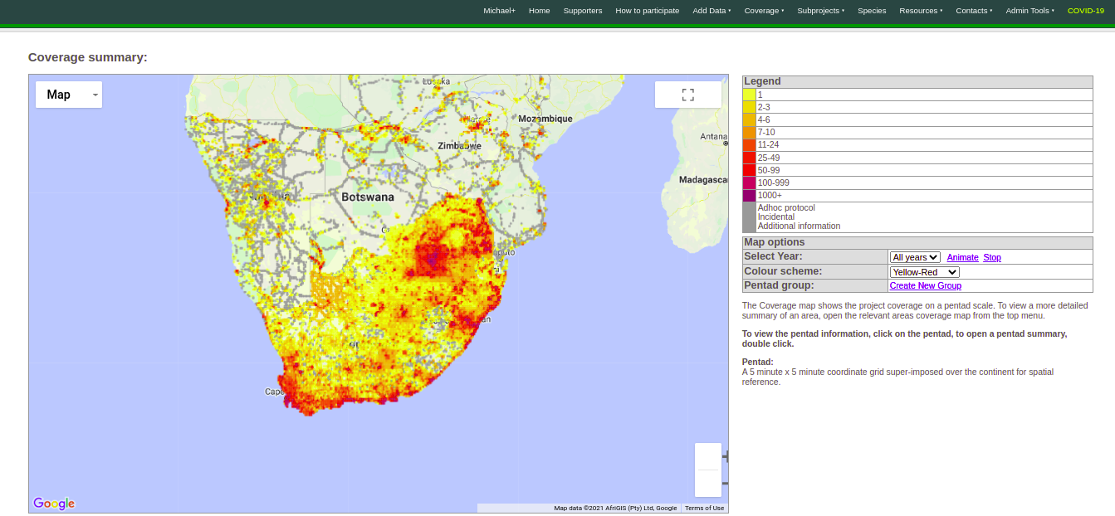
Southern African Bird Atlas Project
2007-ongoing
Detection/non-detection
~17.6 million records
14061 of 16708 pentads (5’ x 5’)
Now also in R!
https://github.com/AfricaBirdData/ABAP

Slide 4
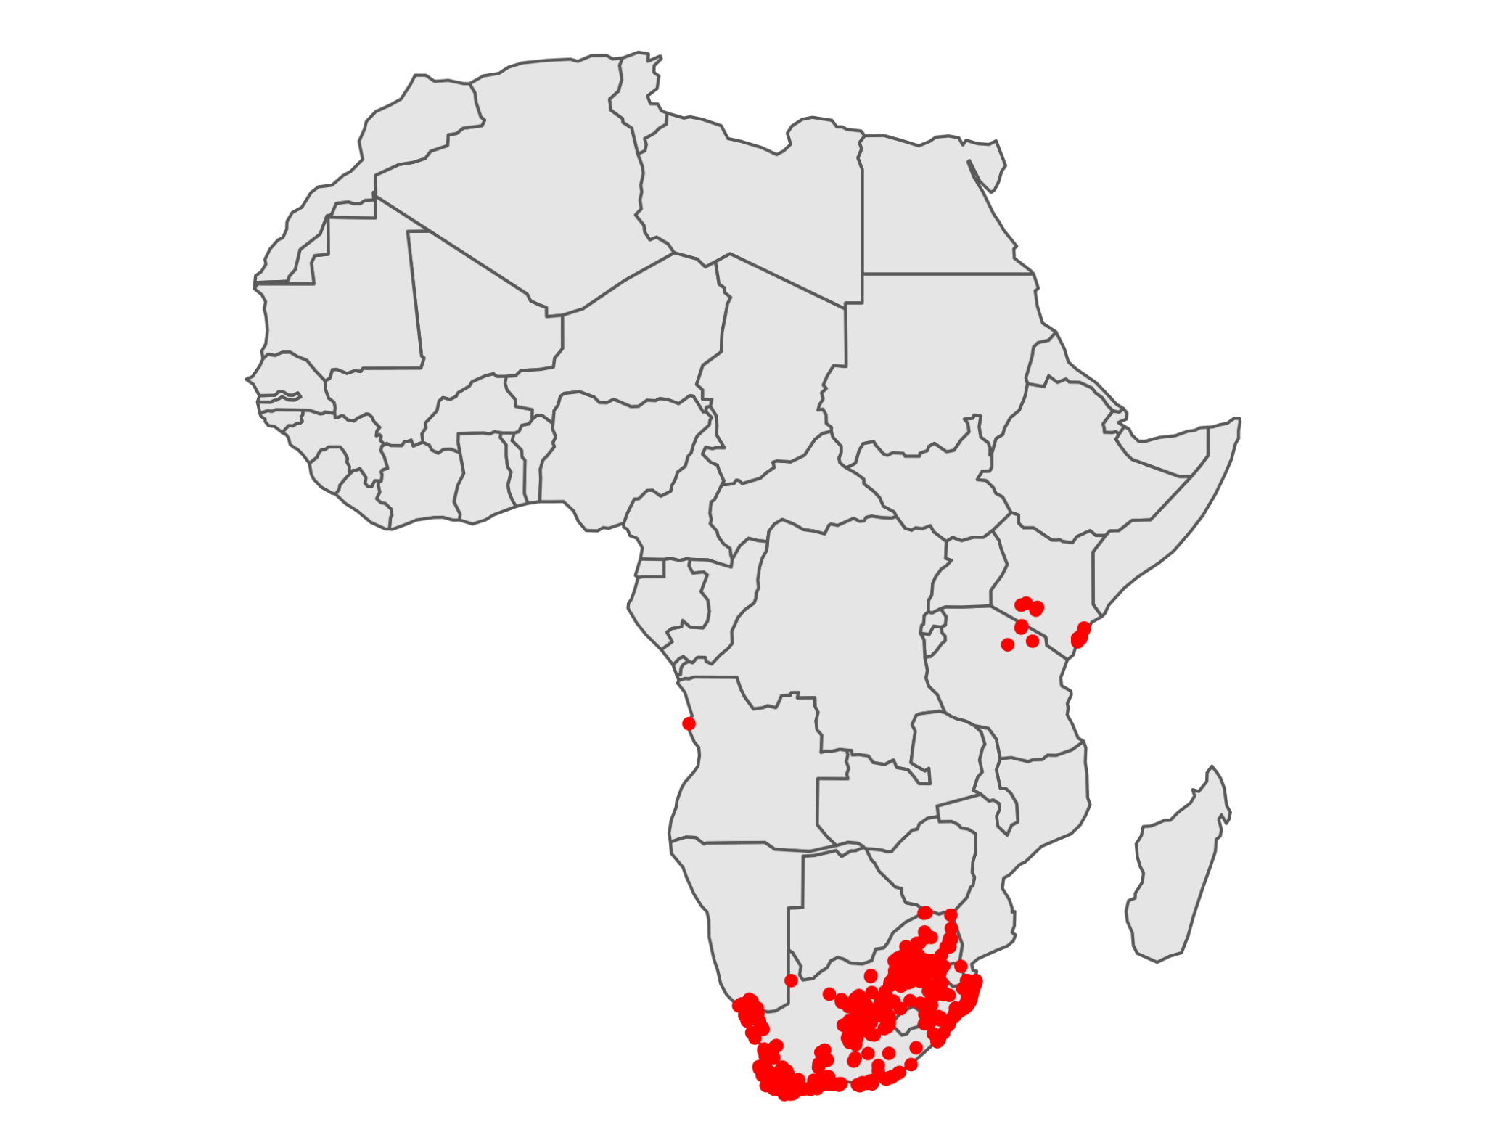
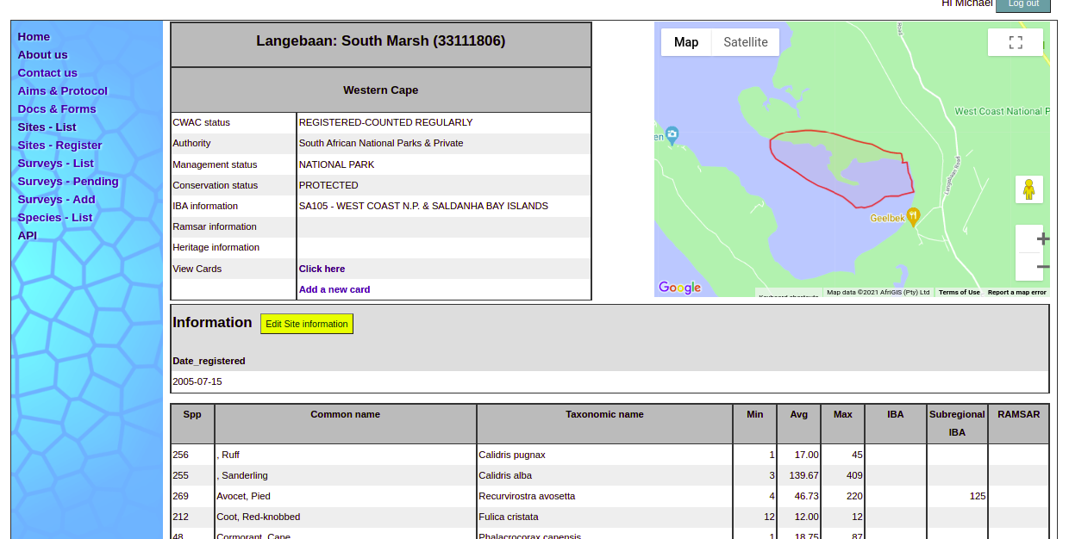
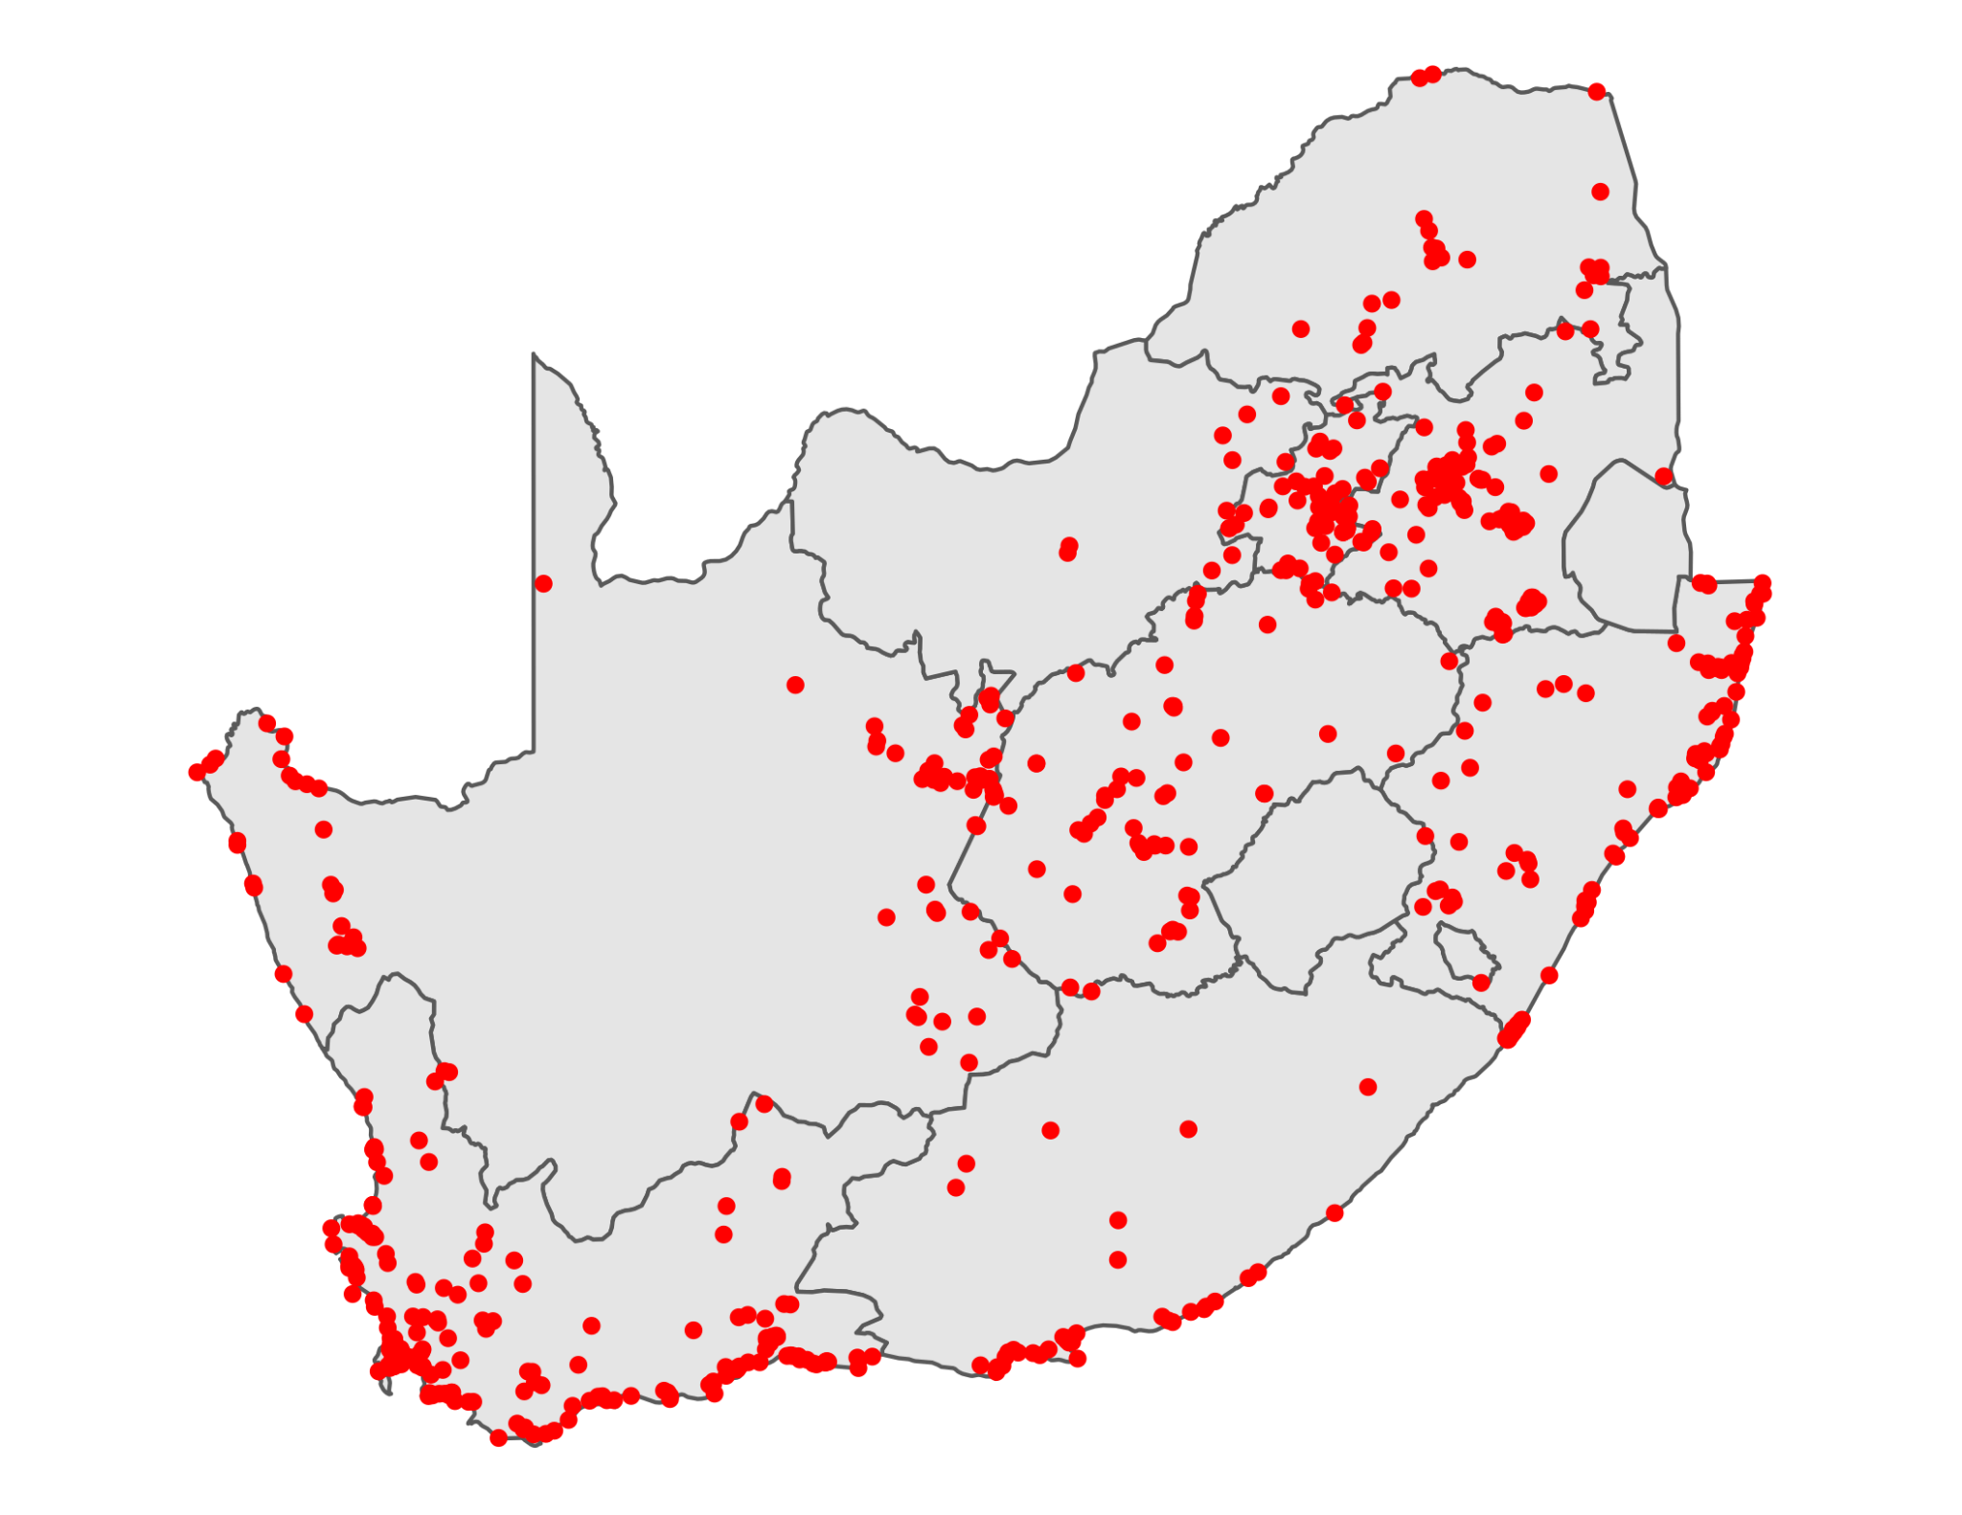
Coordinated Waterbird Counts
1992-ongoing
Abundance
~347,000 records
739 sites
Now also in R!
https://github.com/AfricaBirdData/CWAC

Slide 5
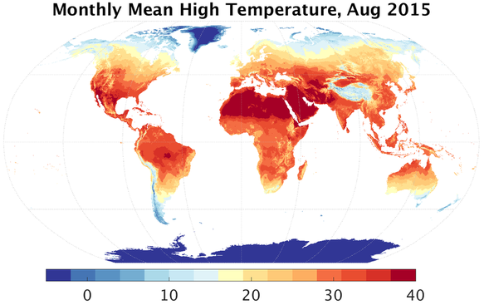
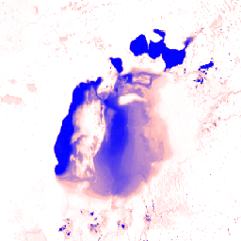


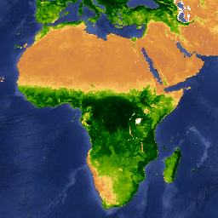
Supporting information
TerraClimate
JRC surface water
MODIS veg. indices
Wetland inventory

Slide 6
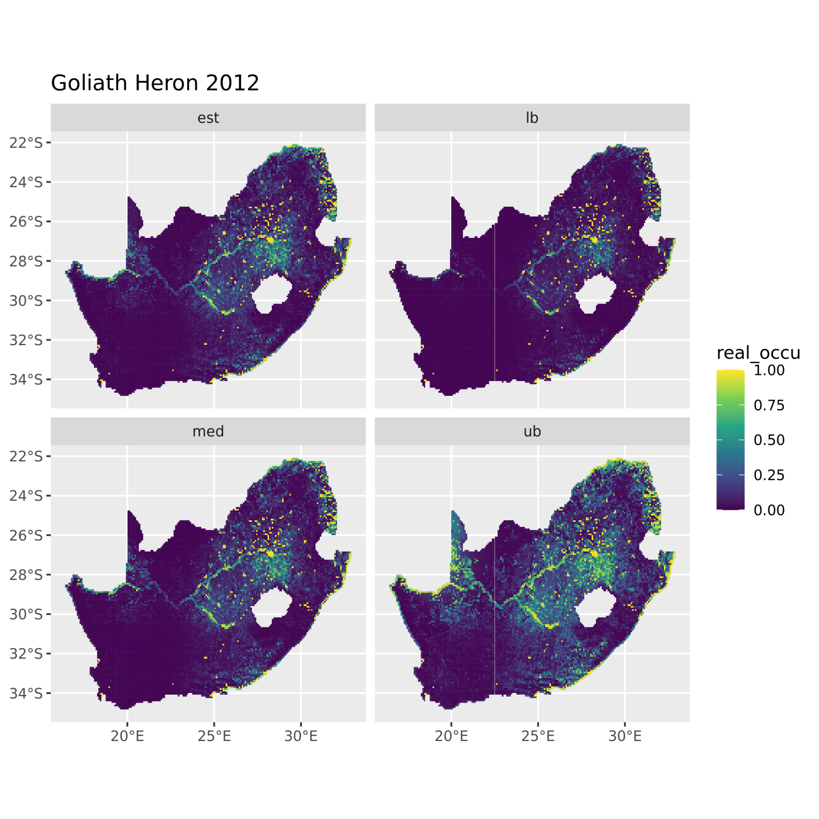
Species distribution
Estimate
Lower bound
Occupancy models for ABAP
Bayesian framework
Occupancy per pentad, year and species
Derived indicators:
Area of occupancy
Extent occurrence
…
Median
Upper bound

Slide 7
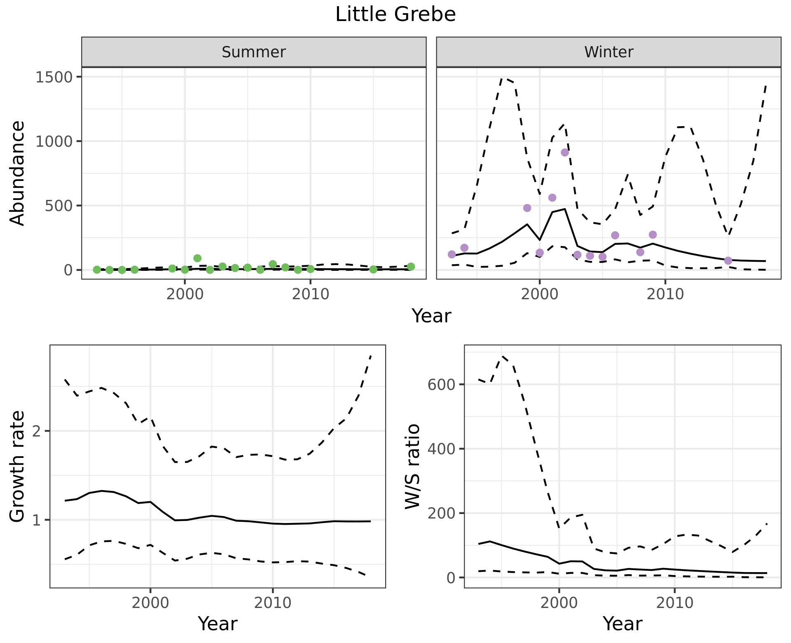
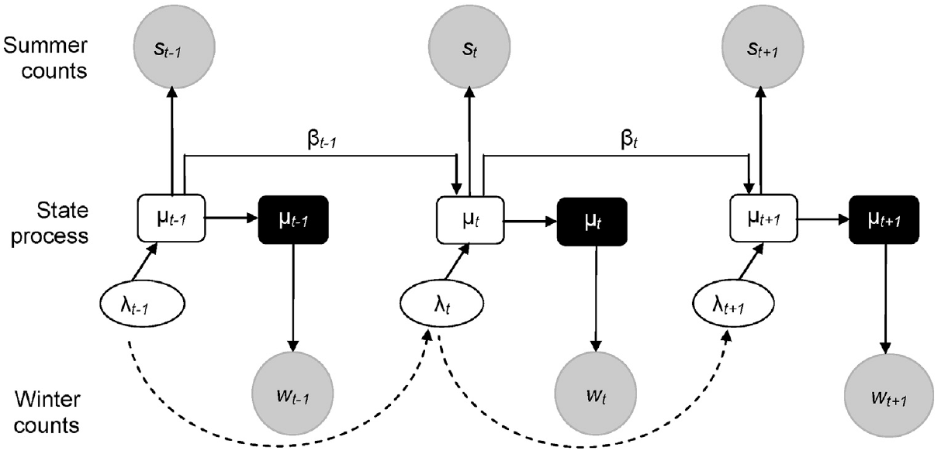
Species abundance
State-space model for CWAC
Bayesian framework
Species- and site- specific models
Aggregate results to obtain abundance at larger scales
Barshep et al. 2017, Global Eco. and Con. 12

Slide 8
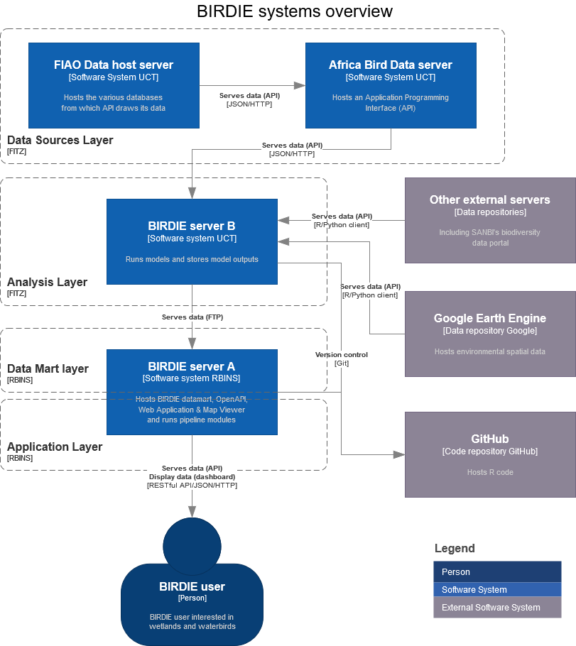
Data server
Analysis
Support
Presentation
Decisions

Slide 9
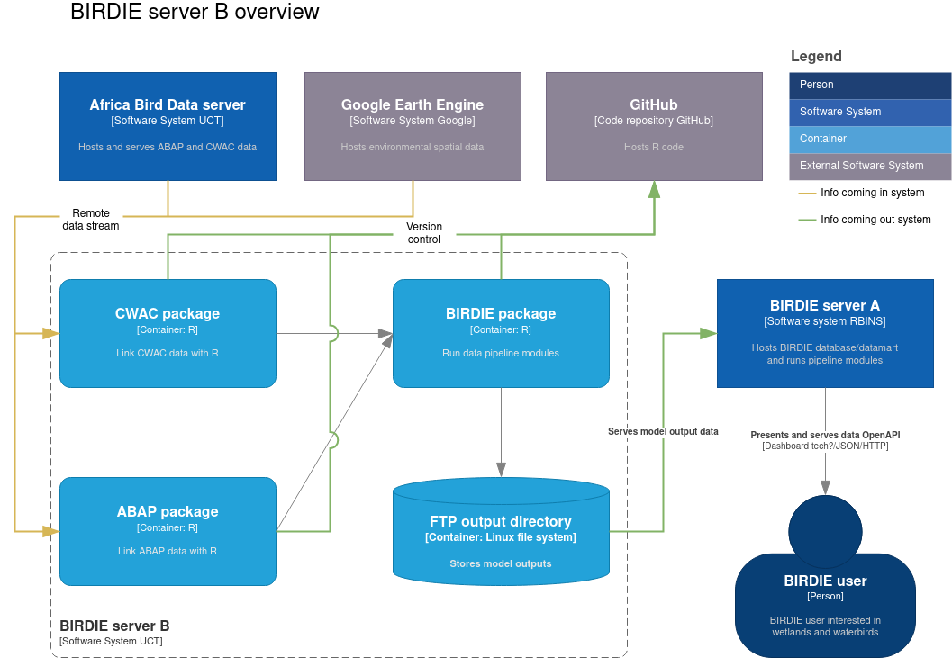

Slide 10
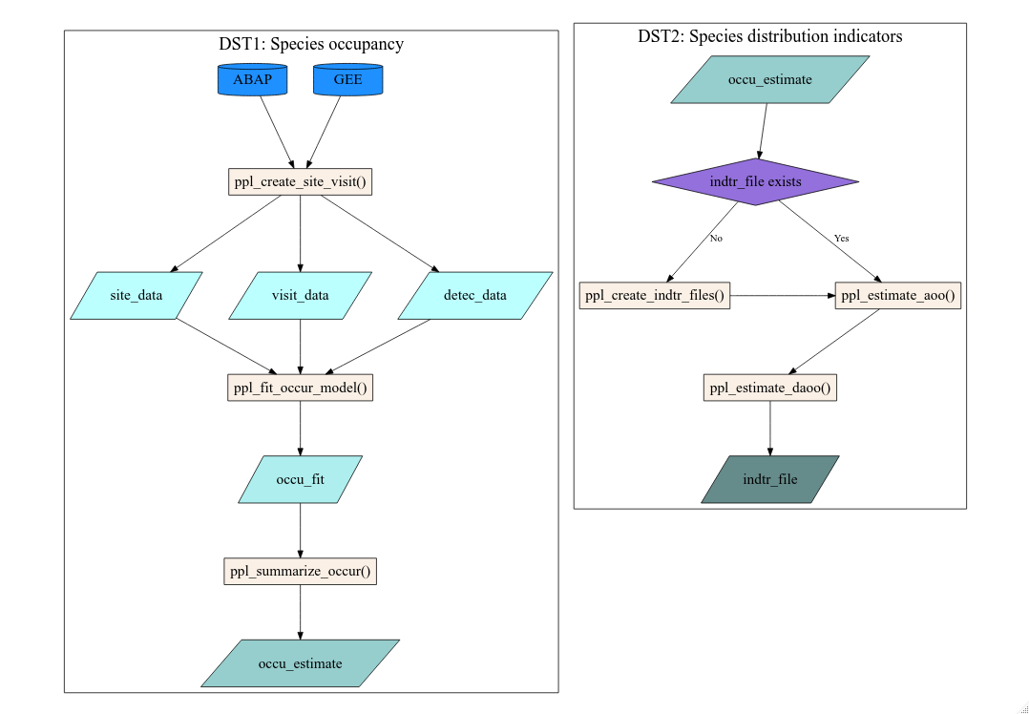

Slide 11
